Slide 1
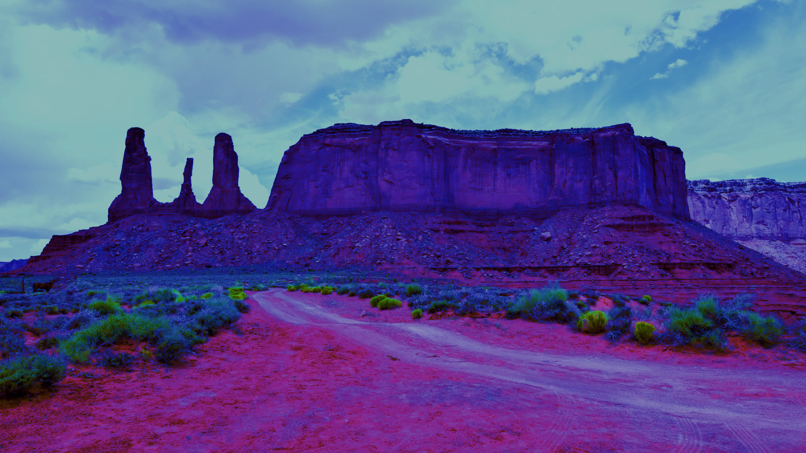
NNR-21-417: Final Report and Dissemination Plan
Matt Barnett, Utah State University

Slide 2
Background
Final Dissertation Title: “Toward a More Holistic Understanding of the Uranium-Related Views and Experiences of Residents in the Four Corners Region of the United States.”
22 interviews with residents living in (or near) Crownpoint, NM.
Anti-uranium (n = 19)
Ambivalent (n = 2)
Pro-uranium (n = 0)
Neutral (n = 1)
Used TribalCrit framework (Brayboy 2005).

Slide 3
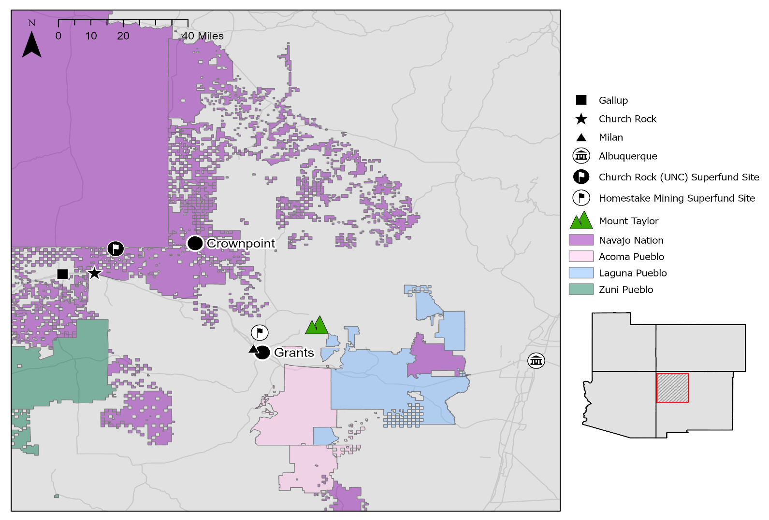

Slide 4
First Tenet
“Indigenous peoples occupy a liminal space that accounts for both the political and racialized natures of our identities.” (Brayboy 2005:429)
Church Rock uranium spill of 1979 (and lack of appropriate response) (n = 11).
Uranium industry and US government exploiting checkerboard (n = 6).
Community impacts of influx of settlers during uranium boom (n = 4).

Slide 5
Second Tenet
“Indigenous peoples have a desire to obtain and forge tribal sovereignty, tribal autonomy, self-determination, and self-identification.” (Brayboy 2005:429).
Participation in anti-uranium activism (n = 5).
Support for anti-uranium activism (n = 5).

Slide 6
Third Tenet
“Tribal philosophies, beliefs, customs, traditions, and visions for the future are central to understanding the lived realities of Indigenous peoples, but they also illustrate the differences and adaptability among individuals and groups.” (Brayboy 2005:429)
Tribal philosophies, beliefs, customs, and traditions (n = 2).
Visions for the future (n = 5).

Slide 7
Quote
“The water tables need to be protected for future generations. There are several communities on the Navajo reservation where water needs to be delivered because the water is contaminated beyond repair. People talk about Flint, Michigan forced to drink and use contaminated water; it’s worse on the Navajo Nation and the Navajo Nation is not being heard.”

Slide 8
Contributions and Limitations
Contributions
Highlights Crownpoint residents’ aversion to new uranium production and provides information about why.
Helps to begin connecting TribalCrit to Indigenous environmental injustices.
Limitations
My positionality as a researcher.
Sample size.

Slide 9
Plan for Dissemination
Eastern Navajo Nation Council
Crownpoint Chapter
Resources & Development Committee
Open to dissemination to other entities!

